Slide 1
Timelines
Why use a timeline to visualize your data?
When reporting on a project, sometimes it can be difficult to see the forest from the trees. By placing your results in a timeline, it can quickly demonstrate to your audience 1) how long it took for results to occur, but also 2) you may see relationships between data points that weren’t as obvious when set in a narrative or list.
What other neat things can I do with these?
If you export your project to a PDF, and have access to Adobe Acrobat, you can make your timelines interactive. This allows you to provide even more context to your visual. As an example, say one of the events on your timeline is a large survey. By making it interactive, you can create a hover-action where a callout box pops up with a few of your favorites survey responses or response ratios. Keep in mind that hyperlinks and hover actions don’t print, so make sure to include the extra data somewhere else in the report, like the appendix. An easier way is to use paid Flipbook apps.
On the following slides, we’ve provided a variety of timeline examples and templates for your use. Enjoy!
What are some things to consider?
Don’t try to include everything on your timeline. Think about which activities, events, and external factors played an important role in the work on your objective (affecting progress either positively or negatively). Keep wording brief – just enough for readers to identify what you are referring to. There may not be room to include specific dates or quantities here. These can be stated in the body of your report where you describe the item more fully.

Slide 2
Tell Your Story Timeline (editable!)
This timeline has been created from within PowerPoint. Navigate to Insert > Illustrations > SmartArt > Process > Alternating Flow. To edit this template, simply click on the various text boxes and change the text, size and/or color.
Year 1
Pre-policy adoption
Build relationships with community groups
Year 2
Pre-policy adoption
Conduct KIIs with law enforcement
Year 3
Policy adopted
Minimum packaging policy adopted
Conduct KIIs with policymakers
Develop educational materials
Conduct public opinion survey
Share information with law enforcement, policymakers
Conduct store observations
Monitor and comment at city council meetings
Release findings at local and statewide press events
Conduct media activity record
Coordinate with policy makers to plan policy implementation
Timeline of key activities

Slide 3
Simple Timeline or Process (editable!)
Everything you see has been created from within PowerPoint. Navigate to Insert > Shapes or Icons to see all your many graphical options.
STEP 1
STEP 2
STEP 3
STEP 4
STEP 6
This is editable text
This is editable text
This is editable text
This is editable text
This is editable text
This is editable text This is editable text
This is editable text This is editable text
This is editable text This is editable text
This is editable text This is editable text
This is editable text This is editable text
This is editable text This is editable text
This is editable text This is editable text
This is editable text This is editable text
This is editable text This is editable text
This is editable text This is editable text
Should your text boxes or graphical elements get out of alignment, click CTRL+ navigate up to Shape Format > Align > choose Align Left (or Right, depending on your viz), and then choose Distribute Vertically. This Alignment panel is one of the most valuable reporting tools in Microsoft PPT and Excel.
Note: Mac users use Shift to select, not CTRL.

Slide 4





Simple Timeline with Icons (editable!)
2017
This is editable text This is editable text
This is editable text This is editable text
2019
This is editable text This is editable text
This is editable text This is editable text
2021
This is editable text This is editable text
This is editable text This is editable text
This is editable text This is editable text
This is editable text This is editable text
This is editable text This is editable text
This is editable text This is editable text
2018
2020
The icons, circles, lines, and dots, have been created from within PowerPoint. Navigate to Insert > Shapes or Icons to see the many graphical options.
Should your text boxes or graphical elements get out of alignment, click CTRL+ all your text boxes that are out of alignment. Navigate up to Shape Format > Align > choose Align Left (or Right, depending on your viz), and then choose Distribute Vertically. This Alignment panel is one of the most valuable reporting tools in Microsoft PPT and Excel.
Note: Mac users use Shift to select, not CTRL.

Slide 5



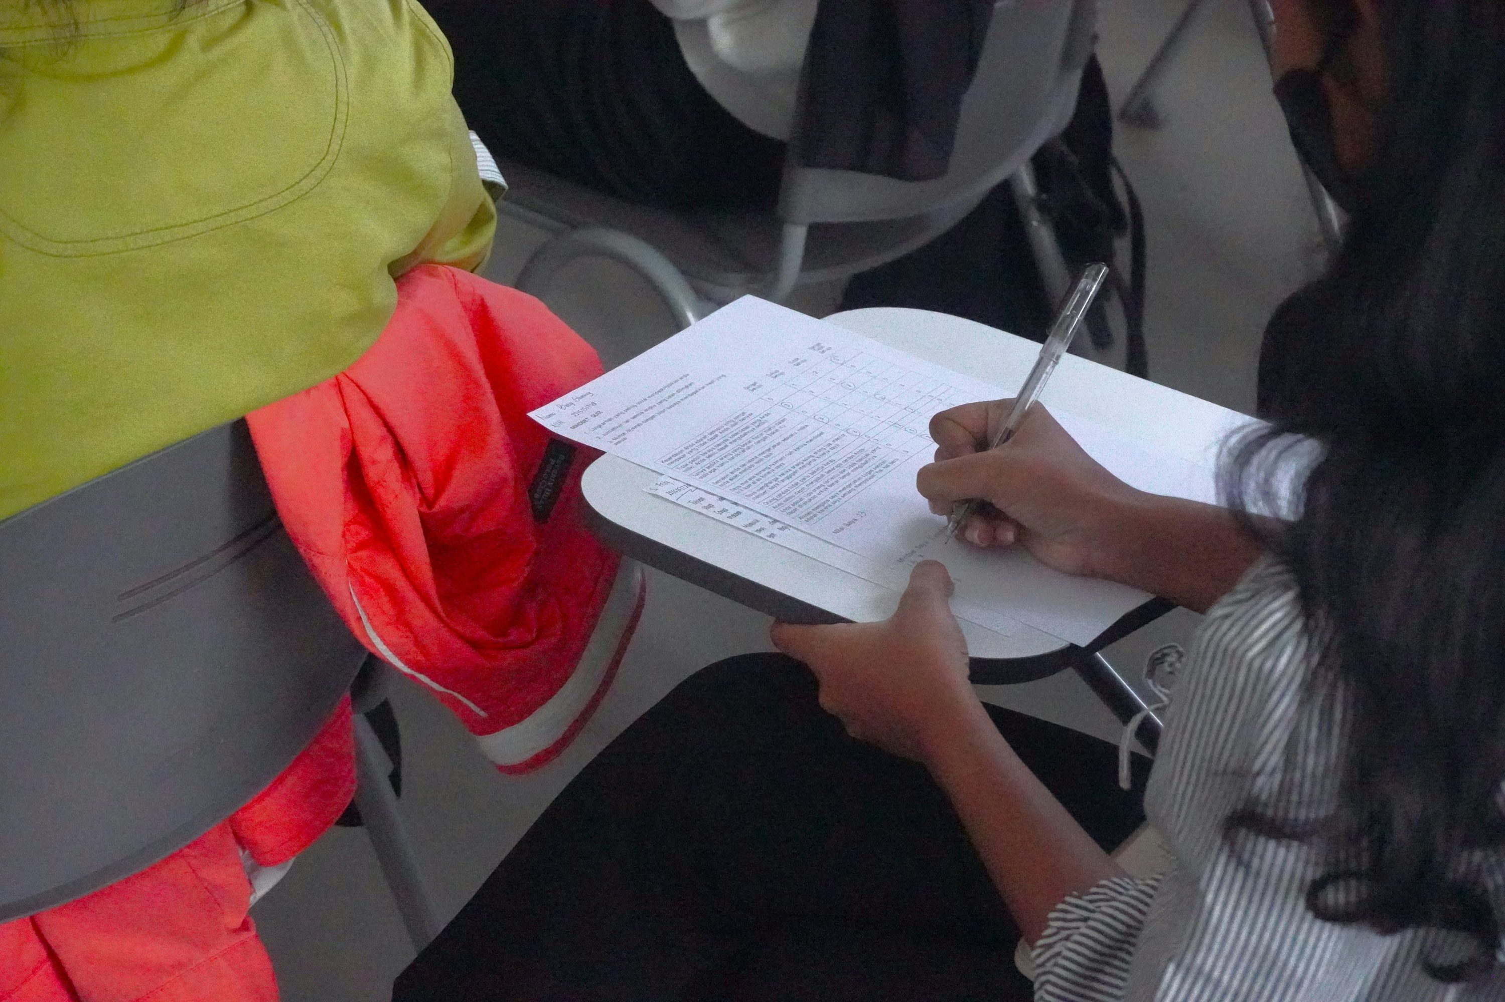

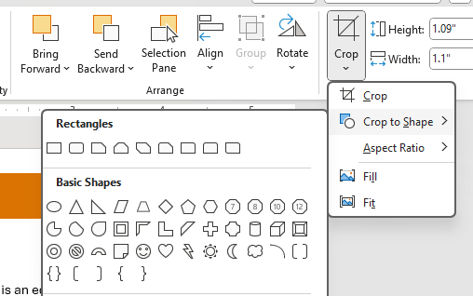
Timeline with Photos (editable!)
[this is an editable text box this is an editable text box this is an editable text box]
[this is an editable text box this is an editable text box this is an editable text box]
Local tabling events
Local surveying
2019
2020
Policy edits
2022
2021
2023
Mayor Meet & Greet
Park Observation
[this is an editable text box this is an editable text box this is an editable text box]
[this is an editable text box this is an editable text box this is an editable text box]
[this is an editable text box this is an editable text box this is an editable text box]
To make your own photos into circles, simply insert or paste your photo onto the page. Then, with it selected, navigate to Picture Format > Crop > Crop to Shape > choose a circle. At that point you’ll need to manually tweak it into your correct shape. Once that is done, click the Crop button again to get out of the Crop functionality and navigate to Height and Width section, minimizing it to a size that works for your needs.
Photos:
https://www.2firsts.com/news/fda-participates-in-tpe24-to-promote-regulations-and-policies
https://unsplash.com/@kobilly
wavebreakmedia_micro at Freepik.com
Nensuria at Freepik.com
EyeEm at Freepik.com

Slide 6
Semi-annual Timeline (editable!)
Jan-Jun
Jan-Jun
Jan-Jun
Jan-Jun
[ edit this text edit this text edit this text edit this text edit this text edit this text edit this text edit this text edit this text edit this text edit this text edit this text edit this text edit this text edit this text edit this text edit this text edit this text edit this text edit this text edit this text edit this text edit this text edit this text edit this text edit this text edit this text edit this text ]
[ edit this text edit this text edit this text edit this text edit this text edit this text edit this text edit this text edit this text edit this text edit this text edit this text edit this text edit this text edit this text edit this text edit this text edit this text edit this text edit this text edit this text edit this text edit this text edit this text edit this text edit this text edit this text edit this text ]
[ edit this text edit this text edit this text edit this text edit this text edit this text edit this text edit this text edit this text edit this text edit this text edit this text edit this text edit this text edit this text edit this text edit this text edit this text edit this text edit this text edit this text edit this text edit this text edit this text edit this text edit this text edit this text edit this text ]
[ edit this text edit this text edit this text edit this text edit this text edit this text edit this text edit this text edit this text edit this text edit this text edit this text edit this text edit this text edit this text edit this text edit this text edit this text edit this text edit this text edit this text edit this text edit this text edit this text edit this text edit this text edit this text edit this text ]
[ Callout box for additional context ]
2021
2022
2023
2024
2025
[ edit this text edit this text edit this text edit this text edit this text edit this text edit this text edit this text edit this text edit this text edit this text edit this text edit this text edit this text edit this text edit this text edit this text edit this text edit this text edit this text edit this text edit this text edit this text edit this text edit this text edit this text edit this text edit this text ]
[ edit this text edit this text edit this text edit this text edit this text edit this text edit this text edit this text edit this text edit this text edit this text edit this text edit this text edit this text edit this text edit this text edit this text edit this text edit this text edit this text edit this text edit this text edit this text edit this text edit this text edit this text edit this text edit this text ]
[ edit this text edit this text edit this text edit this text edit this text edit this text edit this text edit this text edit this text edit this text edit this text edit this text edit this text edit this text edit this text edit this text edit this text edit this text edit this text edit this text edit this text edit this text edit this text edit this text edit this text edit this text edit this text edit this text ]
[ edit this text edit this text edit this text edit this text edit this text edit this text edit this text edit this text edit this text edit this text edit this text edit this text edit this text edit this text edit this text edit this text edit this text edit this text edit this text edit this text edit this text edit this text edit this text edit this text edit this text edit this text edit this text edit this text ]
[ Callout box for additional context ]
Jul-Dec
Jul-Dec
Jul-Dec
Jul-Dec

Slide 7
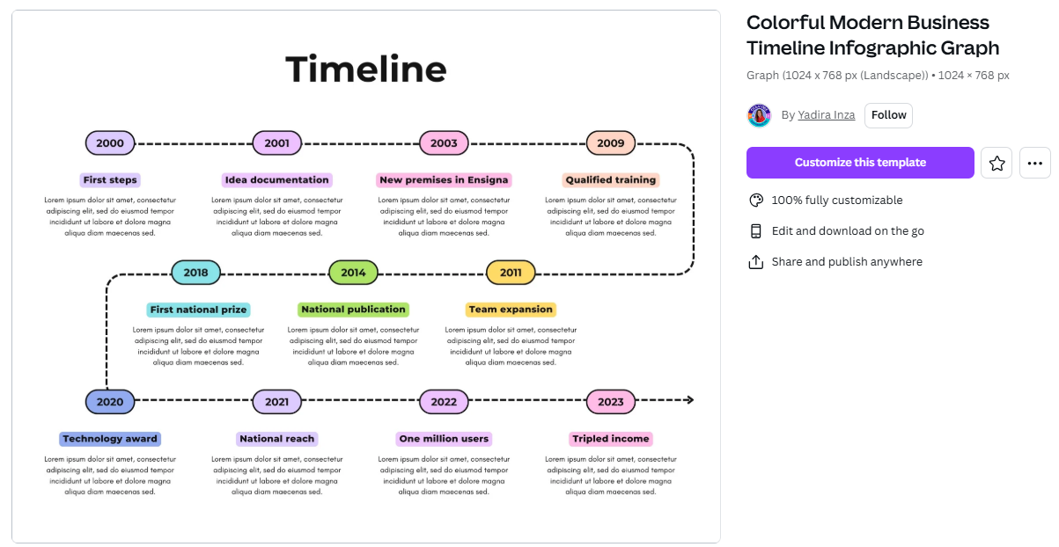
Canva Templates (free!)

Slide 8
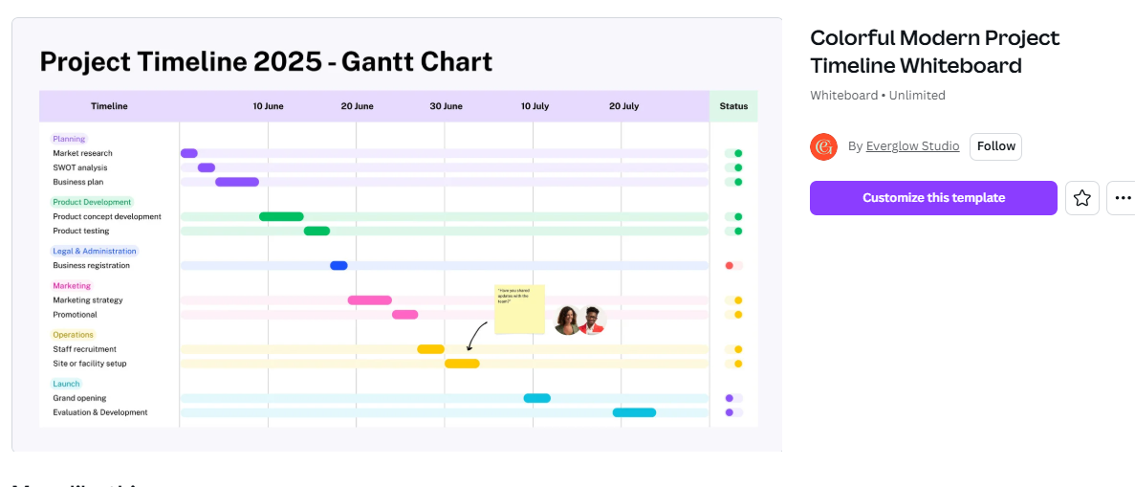
Canva Gantt Chart Template (free!)
On the next page, we’ve shared a recently created timeline We could have simply listed their results in a list, but by placing these actions on the timeline it shows how their actions had a direct cumulative impact on overall gun injuries and death. In this case we used a line chart as the ‘timeline’ and then backfilled their major program contributions. There’s no rule saying you can’t mix and match your data viz!

Slide 9
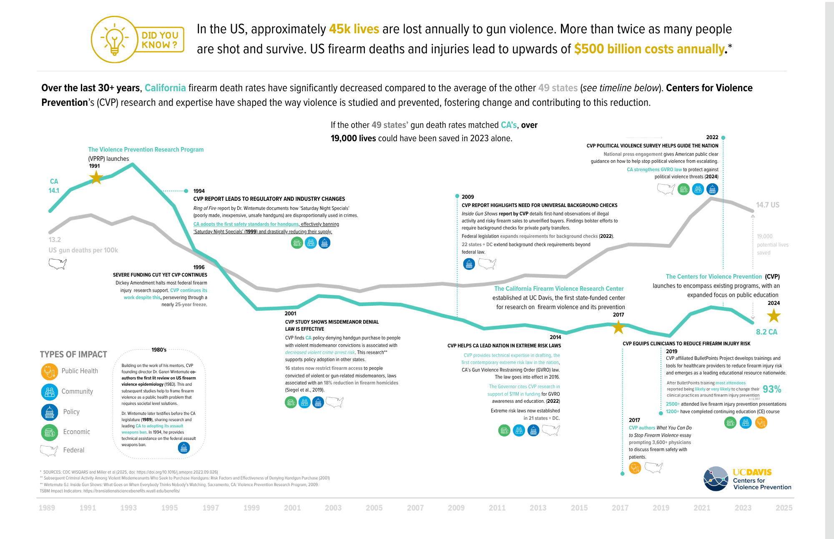
Impact Timeline with Trend Lines (example from a UC Davis project)
To illustrate how one UC Davis program impacted gun deaths in the US, we could have simply listed the results, but by placing these actions on this timeline we show how the project had a direct cumulative impact on overall gun injuries and death. In this case we used a line chart as the ‘timeline’ and then filled in the major program contributions.

